Slide 1
Blake Freeman
Neddy Nyatome

Slide 2
Budweiser
Topics being covered today?
Cleaning the Data
Results
Interesting Facts discovered

Slide 3
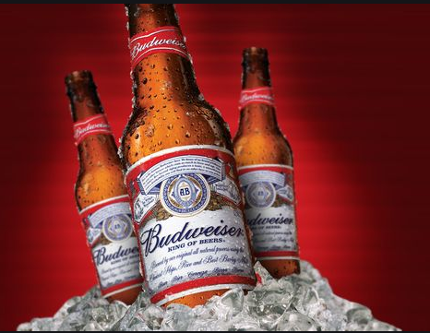
Sample size = 2410
State with most Breweries = Colorado
State with highest medium ABV = DC

Slide 4
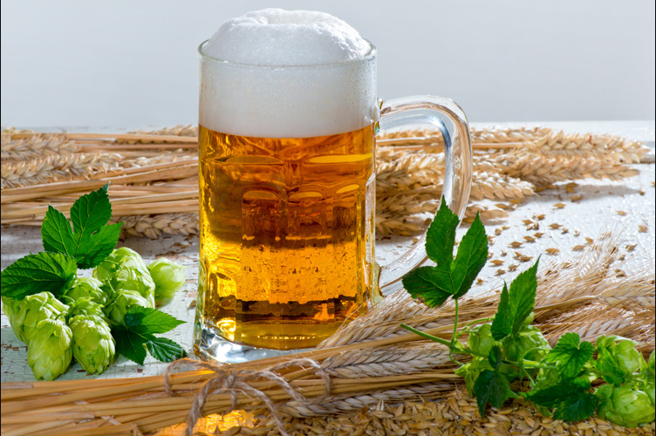
State with highest medium IBU = WV
State with maximum alcoholic beer (ABV) = Colorado with ABV of 0.128 (12.8%)
State with most bitter beer (IBU) = Oregon with IBU of 138

Slide 5
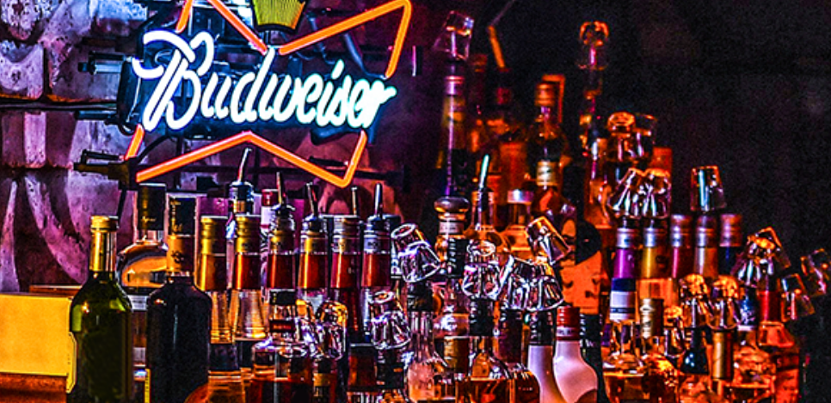
ABV
Expectation: most beers produced with alcohol content range of 5% to 6.7%.
Most occurring alcohol content = 5.6%
Average for all beers = 5.82%
maximum alcohol content by volume = 12.8%
Minimum alcohol content by volume = 0%.
This means:
This is what the market is currently looking for
current standardized brewing process require beers to have this range of content,
Potential untapped markets where they are looking for beers with more alcohol content.

Slide 6
Conclusion on statistics
Frequency distribution shows that the highest median ABV and IBU are 0.0625 (6.25%) and 57.5 respectively
There’s a positive correlation between IBU and ABV where as IBU increase, ABV increases in the Beer
When arranged by their ABV level, the lowest 25% of beers have an ABV of 0.050, the middle 50% of beers have an ABV level of around 0.017.
41.7 % of IBU data values were empty. To qualify the IBU summary data we recommend running the same test on another data sample

